Slide 1
A
CV3
B
T-rep M-1
Image 0
gREST
T-rep 0
Image
0
Image
N-1
Image N-1
CV1
reparameterization
CV2

Slide 2
CV3
T-rep M-1
Image 0
gREST
T-rep 0
Image
0
Image
N-1
Image N-1
CV1
reparameterization
CV2

Slide 3
1. Update images using local mean forces
2. Reparameterize

Slide 4
3. Repeat update/reparameterize until convergence to MFEP

Slide 5
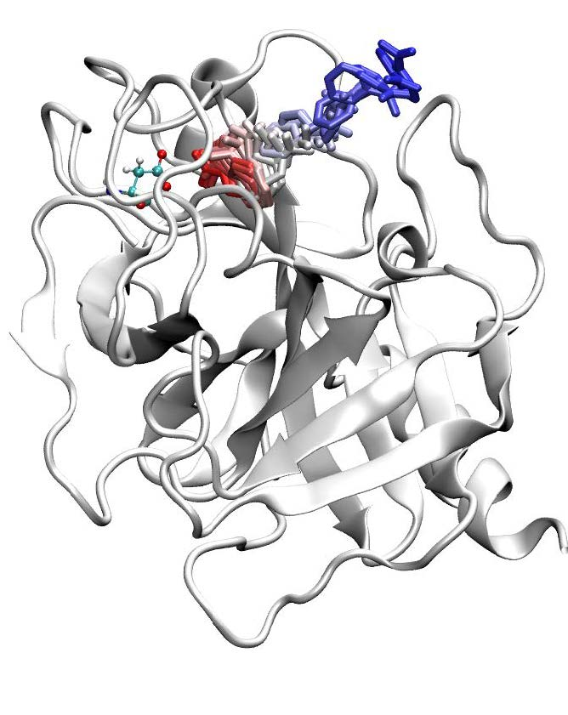
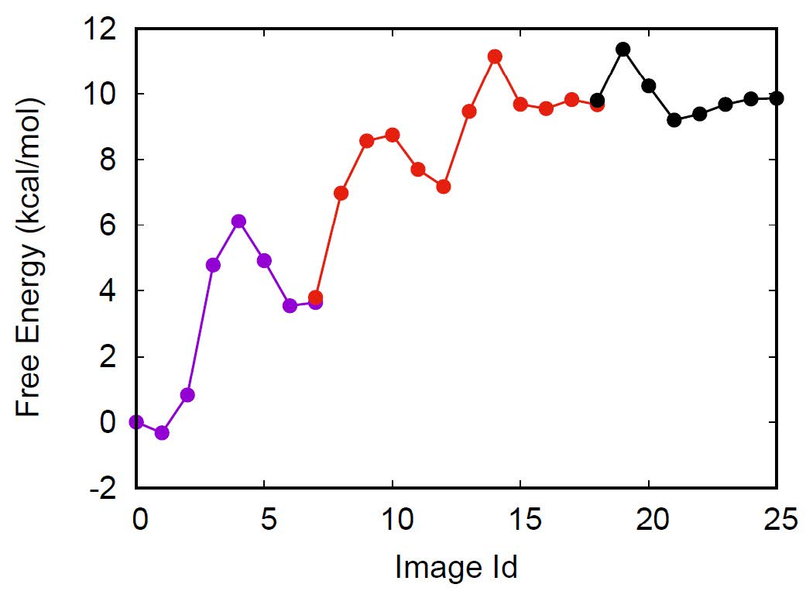
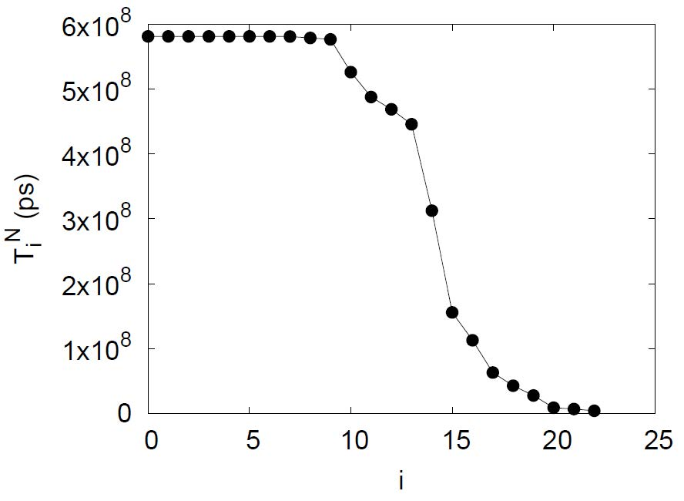
A
B
C

